Slide 1





Fitbit-X
About Us
How it Works
Your Results
Contact Us
Who are we?
Welcome to Fitbit-X, a website where you can upload your Fitbit data to receive in-depth correlations, trends, and insights; all personalized and tailored directly to you!
Our team understands the power of data, and we want to give that power to you. Just follow the two-step process below to get started!
Meet the team
Adele Bloch
Wilson Tam
Kelley Liu
Daniel Hwang
Sarah Cook

Slide 2
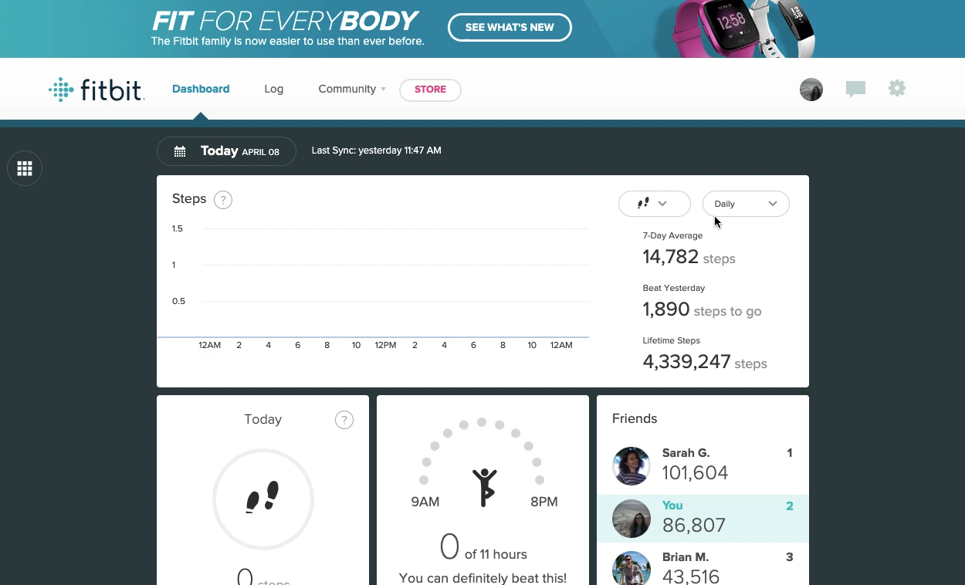

Fitbit-X
About Us
How it Works
Your Results
Contact Us
Step 1: Downloading your data
Who ar we?
Go to fitbit.com.
Click “login” in the upper right corner.
Once logged in, go to the gear icon in the upper right corner and click on settings.
Click data export on the side bar.
Scroll to the bottom of the page and perform an export request.
You will receive an email to confirm the export request.
Once you have confirmed the export request, wait until you receive a “Your export has completed” email, and then download your data.
Step 2: Uploading your data
Almost done! Just upload your data file.

Slide 3
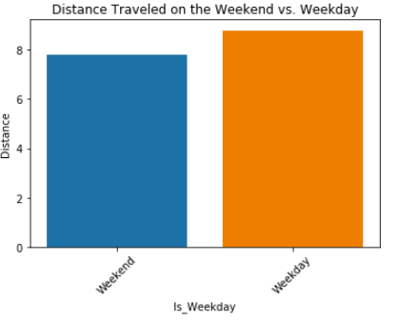
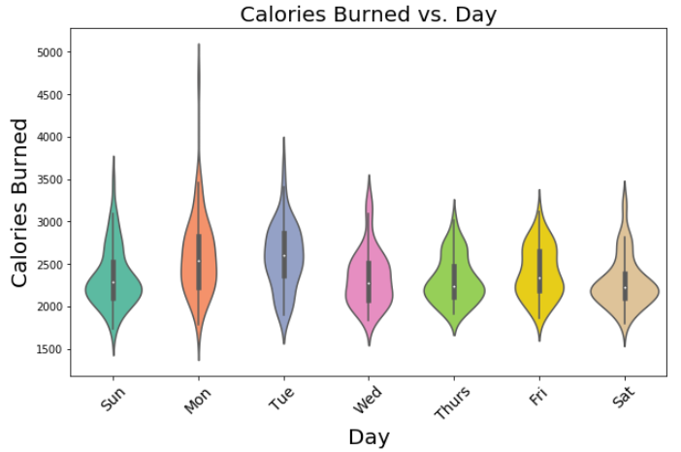
Fitbit-X
About us
How it Works
Your Results
Contact Us
Your results are here!
Use the tabs on the left to explore different aspects of your data.
Heart Rate Trends
Sleep Insights
Exercising Data
Calories Burned
Look at you go! You tend to walk an average of 1.3 miles more on weekdays than weekends.

Slide 4
Fitbit-X
How it Works
Your Results
Contact Us
About us
Meet the Team
Personalized Recommendations
The average Fitbit goal is 10,000 steps per day. Through our machine learning models we will provide daily recommendations based on previous step counts on this given day of the week, the amount of sleep you had, and personal fitness goals! These recommendations will push you to walk a healthy amount, while staying within reasonable expectations for your day-to-day life.
Fitbit automatic goal of 10,000 steps
Actual average step count
Step Count
Daily personalized recommended step goal
M
Tu
W
Th
F
Sa
Su

